Slide 1
DAVE
GameMaker
Ritchie Shekleton N00143569
Claudiu Vladean N00146933

Slide 2
What is Dave?
Dave is a LAN multiplayer co-operative built using Game Maker Studio. With a HTML5 single player connected to a MySQL database.

Slide 3
Background
The original plan was to create a game based around a character that was socially awkward, due to this he would avoid contact with people at every occasion and attempt to get through day to day tasks without contact with others.

Slide 4
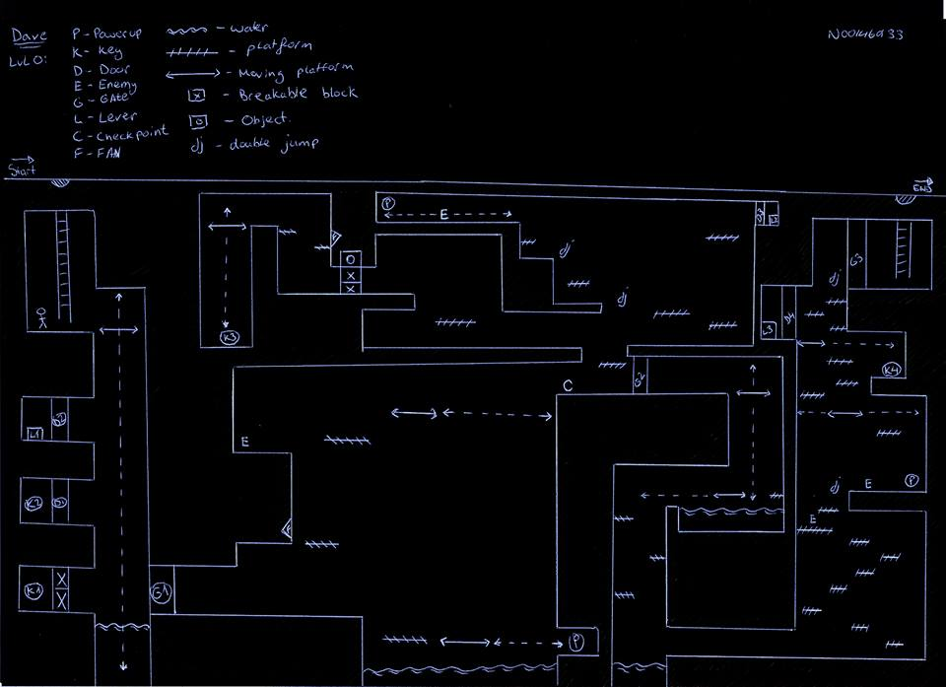
The game design
The level layout went through a few drafts before we had something we were happy with

Slide 5
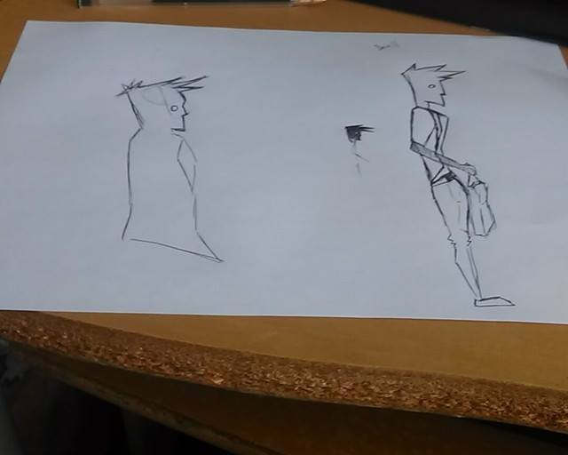
Character Design
The character was first designed on paper and was later scanned and drawn digitally.

Slide 6
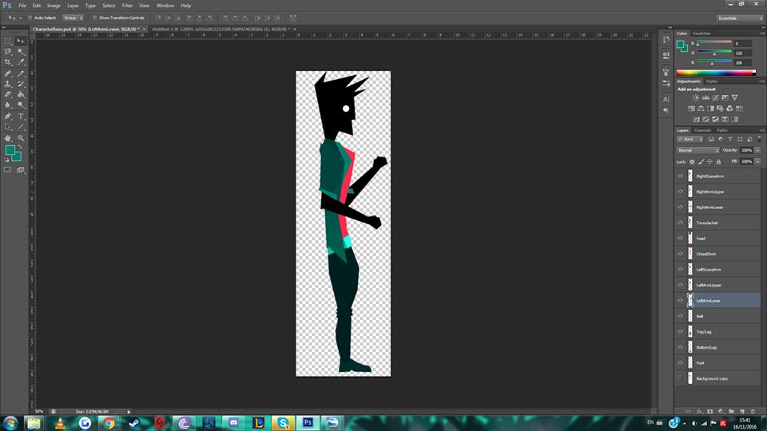
Digital Character
The character was scanned and was drawn over and layered in Photoshop, while exporting the character each movable body part was a separate image so that when the animating process began in Spriter, bones could be given the character making it easier to control and therefore animate.

Slide 7
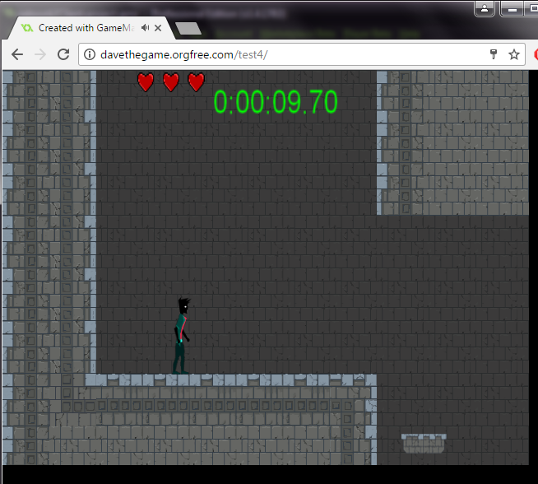
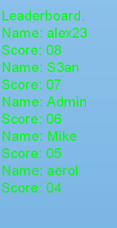
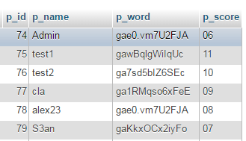
Single Player
Game in browser
PHP
MySQL Database

Slide 8
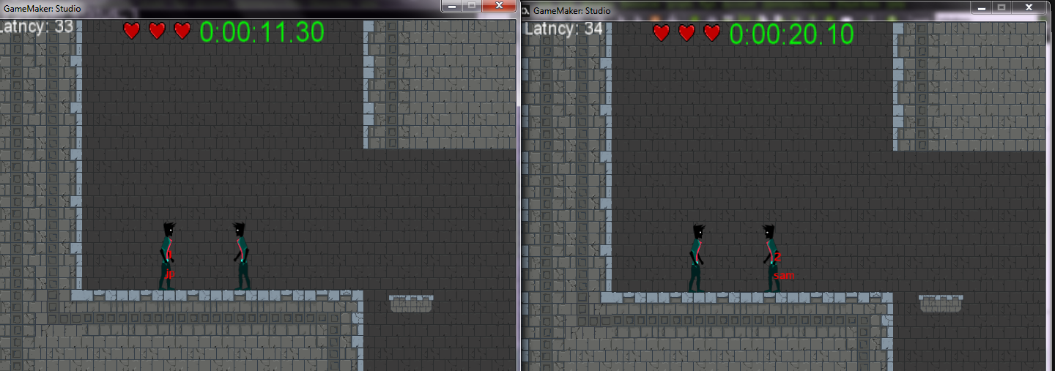
Multiplayer
Server
Two Clients

Slide 9
User Testing
The game was tested by our classmates, most of the changes and debugging was achieved due to this.
Change suggestions included:
-Enemy moving speed.
-Gravity effect on the main character.
-Duration and Respawn of power-ups.
-Collision detection and wall glitches.
-Character masking and level colours.

Slide 10
Questions?

